Slide 1
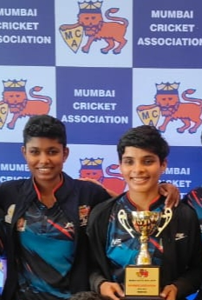
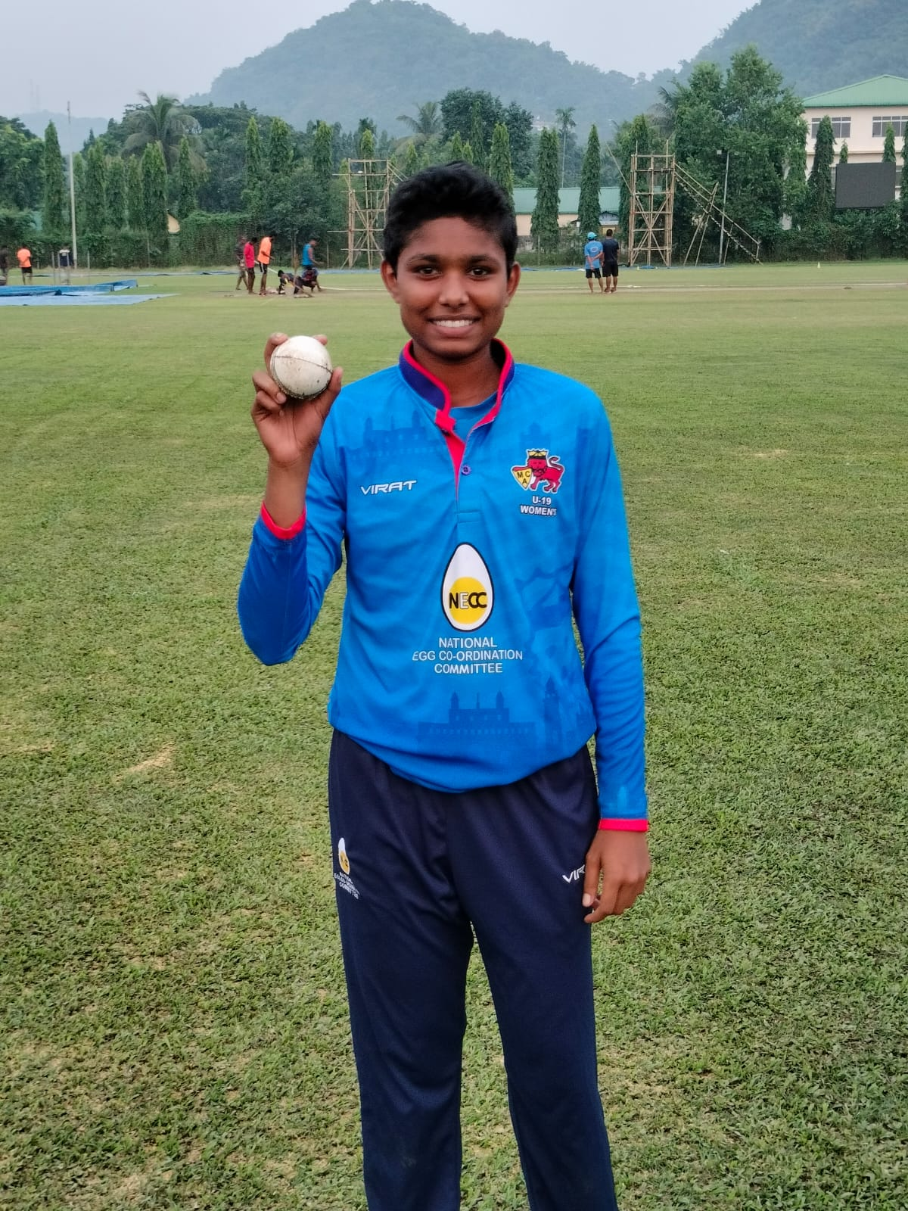
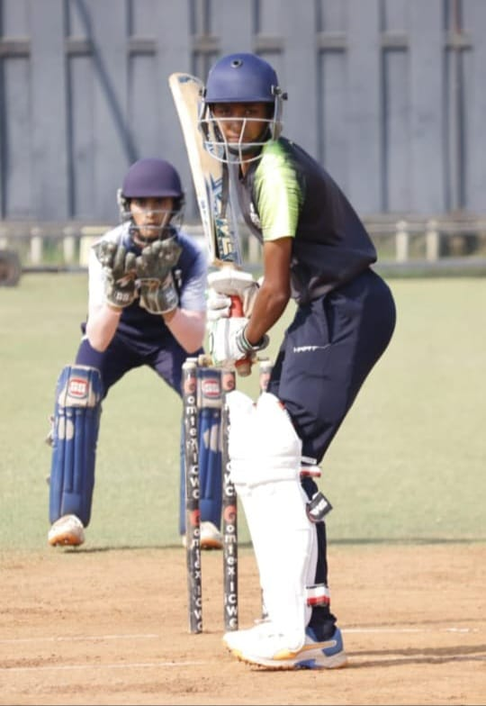
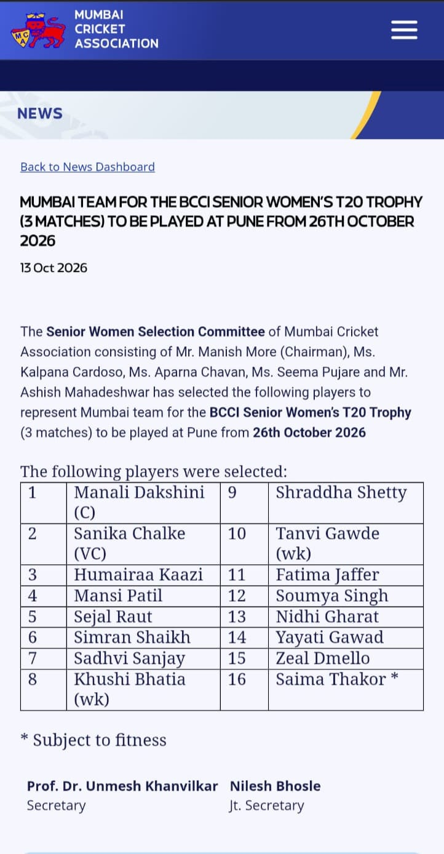
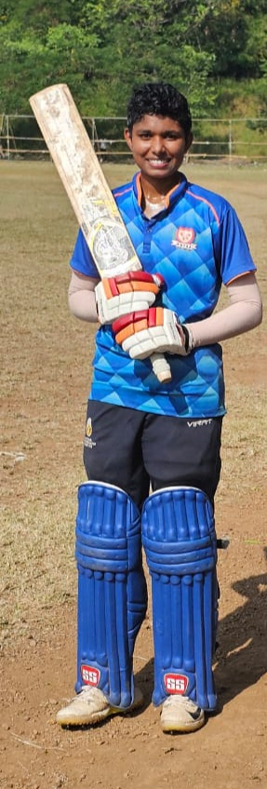
Sports Tarapur- Girls Cricket Coaching Program
Heartiest Congratulation- to Yayati Gavad.
Yayati Gavad is a talented player of the JSW- PDTSA Girls Coaching Program. She has been selected in –
MUMBAI TEAM FOR THE BCCI SENIOR WOMENS T20 TROPHY TO BE PLAYED AT PUNE FROM 26TH OCTOMBER..
We wish her great success, continued growth ,and many more achievement in her cricket journey may she continue to shine and inspire other inspiring girls from rural communities to pursue their dreams.

